Slide 1
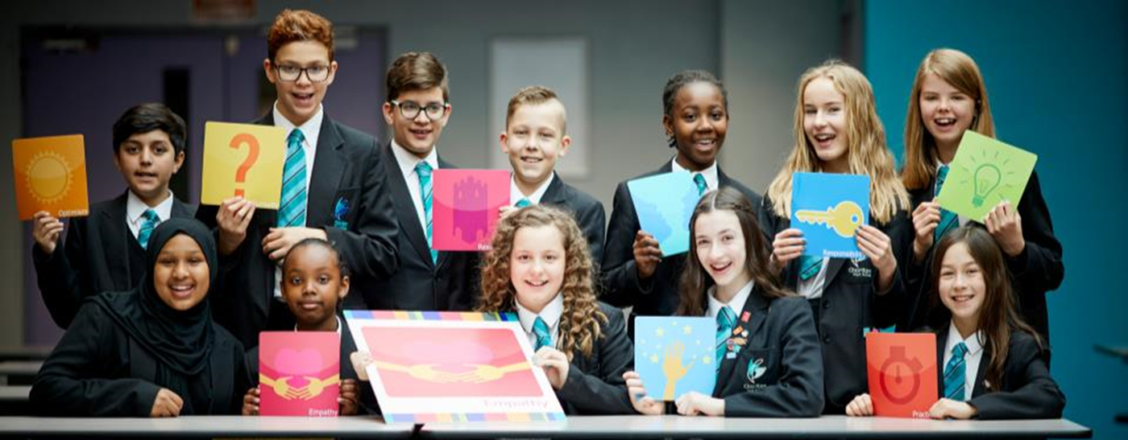
Year 10
Information Evening

Slide 2
Introductions:
The Year 10 team: 2019-20
Ms Irwin – Head of Year 10
Miss Dumville – Year 10 learning mentor
Mr Gosling – Head of Middle school
Ms Banger – Deputy Head Teacher
Fire Alarm

Slide 3
CEIAG Guidance Community
Our job now…….
Get them to start looking forward think about where they want to transition to after they leave CHS
ELE day in Year 9 – KUDOS + Enterprise
Form tutors + tutor curriculum
Careers events – Achievement team
Careers Advisor
Librarians

Slide 4
Year 10
Students are now competing nationally for grades
All subjects have now been reformed and are far more challenging
Content has increased in all subjects
CA’s have been replaced with NEAs which count for less of the final grade
We have to equip them to cope with the harder testing regime…..
We need to develop study HABITS and a clear understanding of what they need to do EARLIER – success is a long journey!

Slide 5
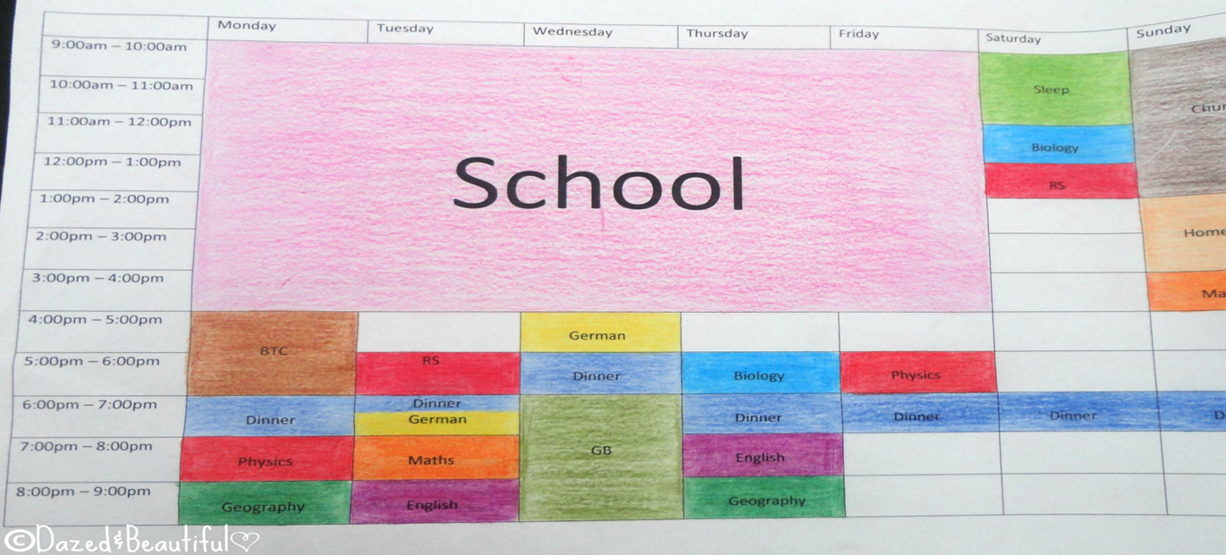
Work habits and Independent learners.
Set a study plan up and help them stick to it! DAILY ROUTINES
Ensure phones are switched off and put away
Join in extra curricular and whole school activities – BALANCE and WELLBEING
If home learning tasks are not set for that night –be independent and do some reading round / online
Keep an eye on long term plan - strong foundations in Y10 will support success long term!
Use feedback from tasks / tests to inform Independent learning – GROWTH MINDSET – YET!!!

Slide 6
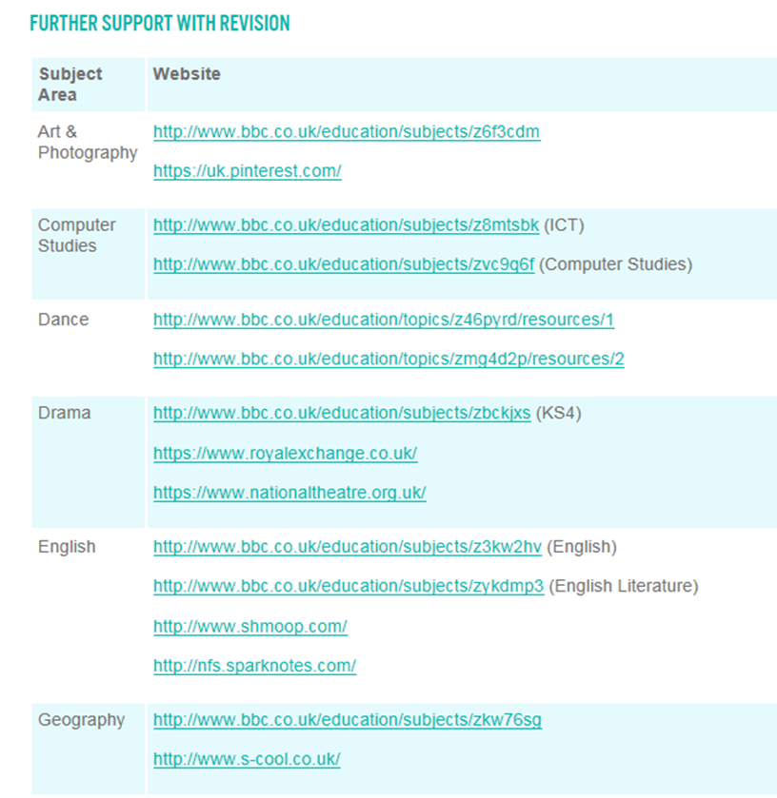
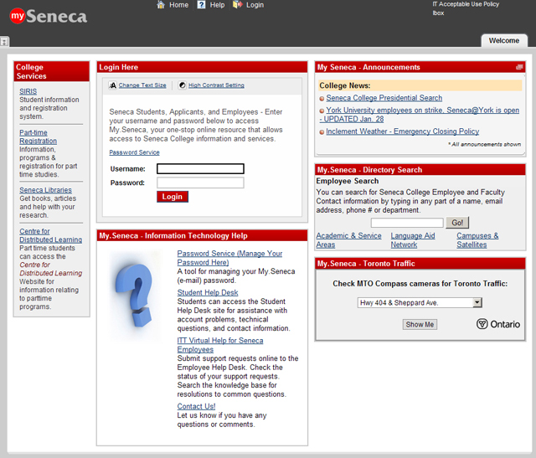
Revision resources…

Slide 7
We know that generally speaking:
4/5 Level 1 to 4’s
Move onto Level 1 courses
Traineeships
Foundation Learning
SOME Level 2 Apprenticeships
6+ Level 4 to 6’s
INCLUDING Level 4 in English + Maths
Move onto Level 2 Vocational courses
Level 2 Apprenticeships
Some may be offered level 3
8+ Level 5/6/7’s and above
INCLUDING level English + Maths
Move onto A Levels
Level 3 Vocational courses
Level 3 Apprenticeships

Slide 8
YEAR 10 JOURNEY OF EXPERIENCE , GROWTH AND ACHIEVEMENT
Developing myself
The SSAT Leadership Programme
Contributing to my community
Working with others
2 form times a week given over to character development using the SSAT Leadership Programme
Notes:
Why the change?

Slide 9
Leadership
There are three steps to the accreditation process:
Self-assessment against graded criteria
Evidence collation and portfolio creation
Moderation and accreditation

Slide 10
Leadership
Developing myself
1. Commitment Attend extra-curricular clubs Complete ‘Be Ready Monday’ cards Student Council Duke of Edinburgh Award High conduct and effort grades Fully complete homework Complete work experience
2. Organisation and planning Duke of Edinburgh Award Sports coaching and leadership Organise a charity fundraiser Advertise a charity fundraiser Create revision timetables and materials
3. Communication Student Council Lead a revision session Complete your English Spoken Language Create or contribute to an event within the community
4. Being accountable Homework effort grades Duke of Edinburgh Award Student Council Complete coursework to deadline Complete work experience
Contributing to my community
5. Being a role model Student Council High conduct and effort grades Subject specific leadership Help out within school productions Be a helper at Open Evening Present a year group assembly Be a student mentor Be a school buddy for new students
6. Using my skills to help others Lead extra-curricular clubs Coach lower school sports teams Be involved in a transition event for Y5 and Y6 Organise a charity fundraiser Student Council
7. Understanding my community Help in the school library Be involved in ‘Intergenerational Question Time’ Perform in a show outside of school Work experience Get a job Organise an event outside of school
Working with others
8. Team working Play in a sports team Perform in a production or concert Be involved in a group presentation Student Council Organise a charity fundraiser Duke of Edinburgh Award Complete effective group work within lessons
9. Presenting Student Council Complete your English Spoken Language Be involved in a transition event for Y5 and Y6 Coach lower school sports teams Lead a revision session Be involved in ‘Intergenerational Question Time’ Be a helper at Open Evening Present a year group assembly
10. Challenge and reflection Improve your performance within subjects Complete Feedback Loops within lessons Learn a new skill (language, instrument, trade) Complete work experience and reflecting on performance Seek out feedback from peers and staff Complete a Personalised Learning Checklist (PLC) Attend revision sessions

Slide 11
Work Experience
Monday 3rd February to 14th February 2020
We recommend Self-Placements in an area of interest
Deadline for self-placements is OCTOBER Half term
Good experiences to write about on College Application Forms

Slide 12
Future job growth (2)
Source: Oxford Economics
Notes:
Pie chart shows the distribution of the new jobs referred to in the previous slide across sectors
Shows dominance of service sector and specifically higher skilled professional roles, business support services and leisure activities such as hotels, food and retail.
Also note that self-employment is an option in many of Manchester’s growth sectors
Manchester is an enterprising place – many opportunities to start your own business or work for a smaller company

Slide 13
What made Year 11 last year stand out?
Supportive Staff
Hard Work Started in Y10
Successful Foundations
College Applications
College References
They had AMBITION
They FOCUSED + LISTENED
They planned ahead

